Slide 1

tourly.io
SYSTEM PRESENTATION
SYSTEM DOCS
Tourly
Overview
Implementation
A modern travel-planning platform — architecture, delivery plan, and operating model.
Back-end
Front-end
DELIVERY
/tourly/system-overview
DECK
Schedule
Budget
References
Audience
Status
READY
Stakeholders, engineering reviewers, and the project sponsor.
Eight sections covering the full system and delivery plan.
01
Tourly, Inc. — May 2026
v1.0.0 • 2026

Slide 2
tourly.io
SECTION 01
SYSTEM DOCS
Implementation Processes
Overview
Implementation
Back-end
Tourly is delivered through three iterative phases, each ending in a working build reviewed with stakeholders.
Front-end
DELIVERY
1
Discovery & Design
Schedule
Requirements gathering, user-flow mapping, wireframes, and an approved visual system. Output: design spec and component inventory.
Budget
References
2
Build & Iterate
Two-week sprints. Contract-first APIs with OpenAPI codegen, paired with a React front-end. Continuous integration on every commit.
$ pnpm run typecheck && pnpm run build
3
Launch & Operate
Production deployment with monitoring, log aggregation, and a feedback loop into the next iteration. Hand-off includes runbook and on-call rota.
02
Tourly, Inc.
v1.0.0 • 2026

Slide 3
tourly.io
SECTION 02
SYSTEM DOCS
Back-end Support Systems
Overview
Implementation
Back-end
A typed, contract-first service layer built on Node.js, Express, and PostgreSQL.
Front-end
DELIVERY
Schedule
Sample Endpoint
Response
201 OK
Budget
POST /api/trips
{
References
{
"trip_id": "trp_8f2a",
"destination": "Lisbon",
"itinerary": [ ... ],
"days": 7,
"created_at": 1747641600
"budget": 1800
}
}
API Layer
Data Store
Operations
Express 5 with Zod validation generated from an OpenAPI spec.
PostgreSQL with Drizzle ORM and migration-tracked schemas.
Pino structured logs, healthchecks, and managed deployment.
03
Tourly, Inc.
v1.0.0 • 2026

Slide 4
tourly.io
SECTION 03
SYSTEM DOCS
Front-end User Interface
Overview
Implementation
Back-end
A responsive, accessible client built on plain HTML, CSS, and modern JavaScript — engineered for clarity and speed.
Front-end
DELIVERY
Schedule
Composition
Design System
Tokens for color, type, and spacing keep every screen on-brand.
Budget
<header> nav + brand
References
<main>
hero · destination search
grid · itinerary cards
Responsive Layouts
panel · trip details
CSS Grid and Flexbox adapt from mobile to ultra-wide displays.
<footer> links + meta
Accessibility
Semantic HTML, ARIA labels, keyboard navigation, WCAG AA contrast.
Initial paint < 1.2s
Mobile-first breakpoints
Zero runtime framework lock-in
04
Tourly, Inc.
v1.0.0 • 2026

Slide 5
tourly.io
SECTION 04
SYSTEM DOCS
Schedule
Overview
Implementation
Back-end
A 16-week delivery plan with phase reviews at weeks 4, 10, and 14.
Front-end
DELIVERY
PHASE
WEEKS
TIMELINE
Schedule
Discovery & Design
W1 – W4
Budget
Research, wireframes, brand
References
Back-end Build
API, database, auth
W3 – W10
Front-end Build
W5 – W12
UI, integration, polish
QA & UAT
W11 – W14
Testing, accessibility, perf
Launch & Hand-off
W14 – W16
Deploy, docs, training
05
Tourly, Inc.
v1.0.0 • 2026

Slide 6
tourly.io
SECTION 05
SYSTEM DOCS
Budget
Overview
Implementation
Back-end
A 16-week build budget with a 10% contingency reserve.
Front-end
DELIVERY
LINE ITEM
ALLOCATION
USD
BURN RATE
Schedule
Engineering
10,000
1,800 /week
45%
$54,000
Budget
Design & UX
5,000
20%
$24,000
References
Infrastructure
5,000
RECURRING OPS
12%
$14,400
KES 7,500 / month
QA & Testing
5,000
13%
$15,600
Contingency
5,000
10%
$12,000
PAYMENT SCHEDULE
Four phase-gated milestones at 25% each.
KES = 30,000
Total
100%
$120,000
06
Tourly, Inc.
v1.0.0 • 2026

Slide 7
Ready to Build
Tourly delivers a typed, contract-first travel platform on a 16-week schedule for a fixed budget — with a clear hand-off plan and room to grow.
16-week delivery
Fixed $120K budget
Typed end-to-end stack
07
Tourly, Inc.

Slide 8

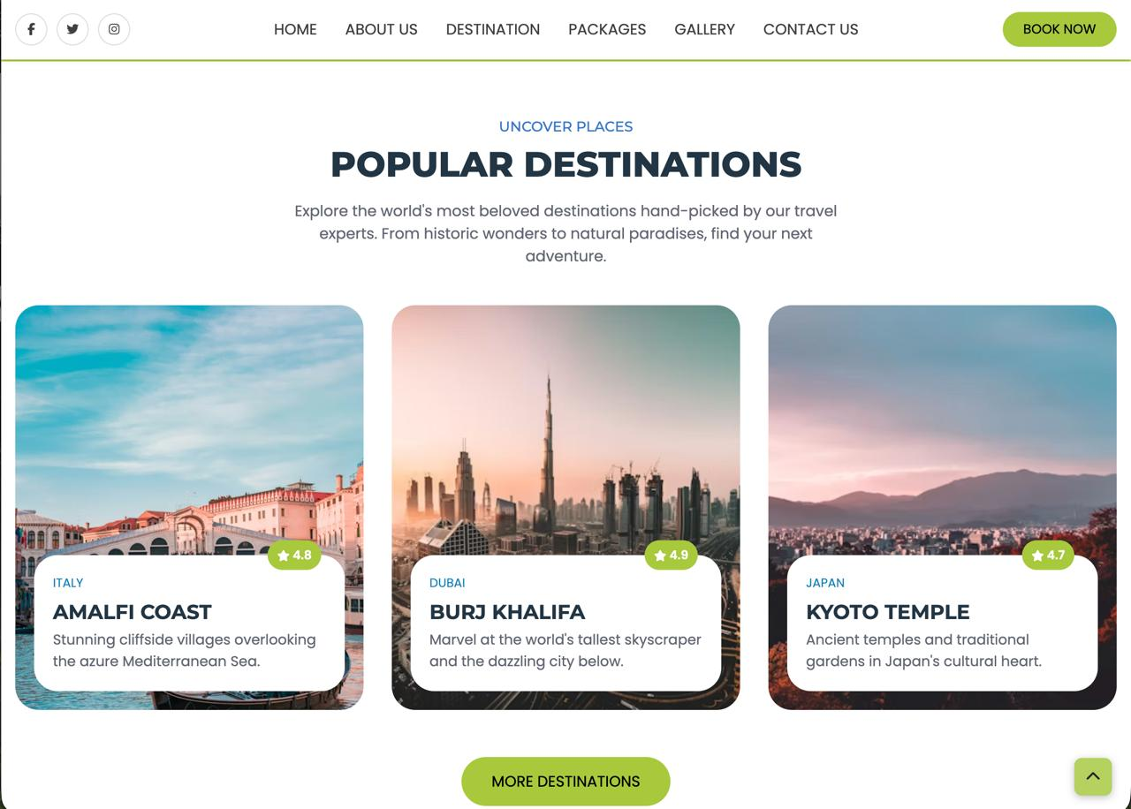

Slide 9
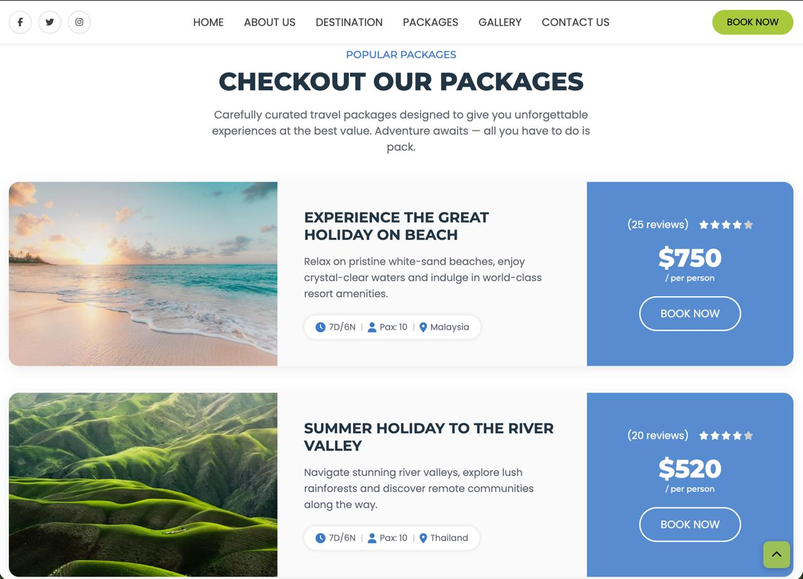


Slide 10
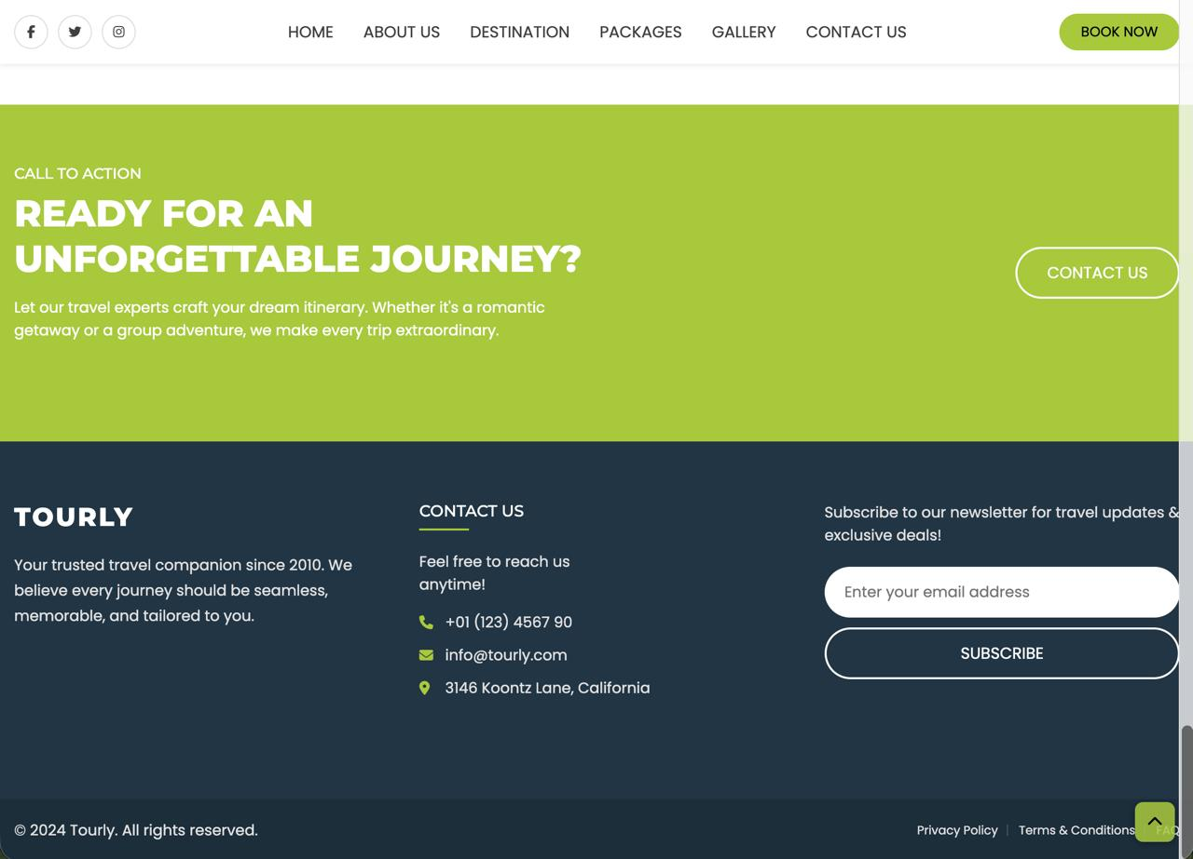

Slide 11
tourly.io
SECTION 06
SYSTEM DOCS
References
Overview
Implementation
Back-end
Sources informing architecture, standards, and delivery practices.
Front-end
[1]
Fielding, R. T. (2000). Architectural Styles and the Design of Network-based Software Architectures.
DELIVERY
Schedule
Doctoral dissertation, University of California, Irvine.
Budget
[2]
OpenAPI Initiative (2024). OpenAPI Specification 3.1.
References
spec.openapis.org/oas/v3.1.0
[3]
Mozilla Developer Network (2025). Web Docs: HTML, CSS, and JavaScript references.
developer.mozilla.org
[4]
W3C Web Accessibility Initiative (2023). Web Content Accessibility Guidelines (WCAG) 2.2.
w3.org/TR/WCAG22
[5]
PostgreSQL Global Development Group (2024). PostgreSQL 16 Documentation.
postgresql.org/docs/16
[6]
Project Management Institute (2021). A Guide to the Project Management Body of Knowledge (PMBOK Guide), 7th ed.
Newtown Square, PA: PMI.
08
Tourly, Inc.
v1.0.0 • 2026

